Slide 1
Pose transfer
to a 3D Model
Professor: M.Gopi
Mentor: Jia Chen
Kookmin University
Seongsil Heo
Notes:
Hello everyone. My name is Seongsil Heo. For this summer seesion program, I can have experience on computer graphics. My project title is pose transfer to a 3d model. My professor is Gopi, and my mentor is Jia Chen.

Slide 2
01
02
03
Why
What
How
Notes:
I would like to have a presentation for 3 steps. Why, What, and how.

Slide 3
01
02
03
Why
What
How
Notes:
First, I will talk about why we do this project.

Slide 4


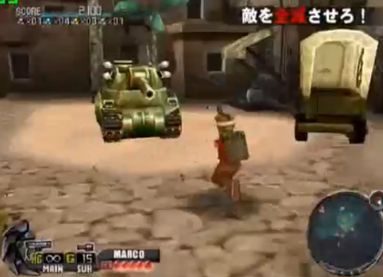

Creating 3D objects is hard for non-professional.
Notes:
Recently, many people like watching 3D movies and playing 3d games. However, it is difficult for non-professionals to create 3D objects.

Slide 5
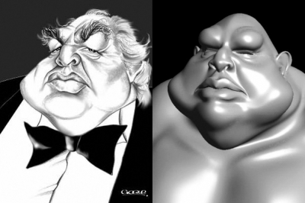
3D Modeling?
Process of developing
a mathematical representation
of any three-dimensional surface
of an object via specialized software.
Notes:
So we are going to make a program by transferring 2D to 3D automatically. It is called 3D modeling. 3D modeling is a process of developing a mathematical representation of any three-dimensional surface of an object via specialized software.

Slide 6
02
01
03
Why
How
What
Notes:
Next, I will talk about what are we going to do.

Slide 7
System design
Part 1: 2D image understanding, find
the pose from the image
Part 2: Use the pose to control 3D model
Notes:
These are the system design of our project. Part 1 is 2D image undersanding and find the pose from the image, and part 2 is to use the pose to control 3d model.

Slide 8





2D
3D
Notes:
To make the 3D modeling program, we will download the image or video. And we will transfer them to 3D/ applying computer vision and geometry processing. We will use opencv, and libigl library in our project.

Slide 9
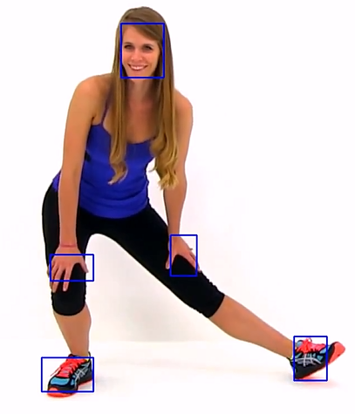
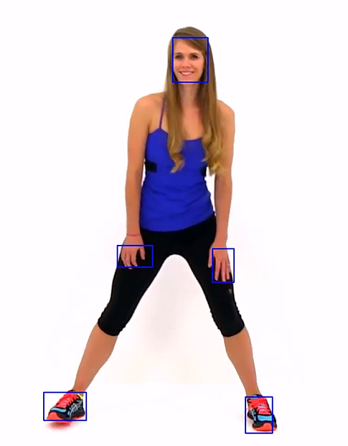
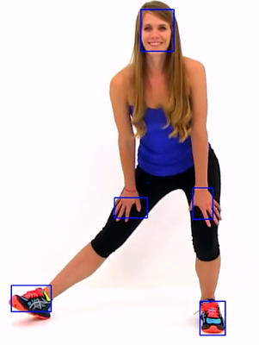
Extract the pose and movement of a person using opencv!
Notes:
At first, we extract the pose and movement of a person accurately in real time using opencv. Like this picture, we track the face, hands, and foots in real time.

Slide 10
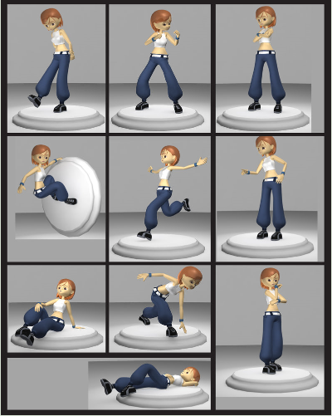
Make a person
pose and move
naturally, smoothly
in 3D.
Notes:
Next, we make a person posing and moving in 3D naturally and smoothly using libigl library.

Slide 11
03
01
02
How
Why
What
Notes:
The last step is how. Let me introduce the way of making this program.

Slide 12
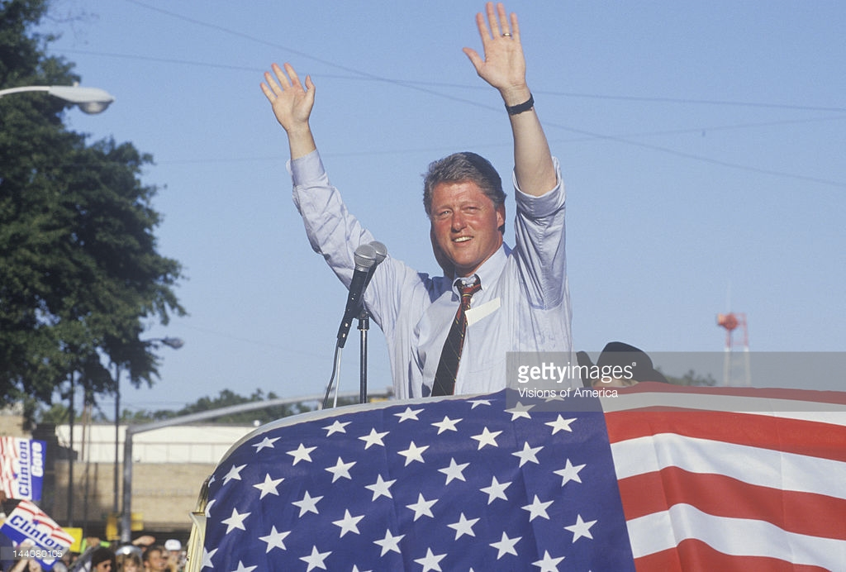
Pose and movement extraction
Use Haar-cascade
in OpenCV to extract
the hands and face etc automatically.
It is limited only an object who has face and hands.
Notes:
I am going to talk about the pose and movement extraction first. I first try to use Haar and cascade classifier in opencv. I can extract the face and hands automatically. However, it is limited to extract any pose and movement.

Slide 13
Tracking algorithm
Optical flow
Meanshift
TLD
Notes:
I want to let users decide the part of the object by themselves. So I decided not to use haar and cascade classifier and use tracking algorithm such as option flow, meanshift, TLD etc.

Slide 14
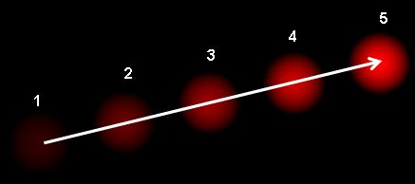
1. Optical flow method
The pattern of apparent motion of image objects between two consecutive frames.
Notes:
First, we have an optical flow method. Optical flow is the pattern of apparent motion of image objects between two consecutive frames

Slide 15
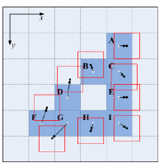
Divide the frame to blocks
in fixed size,
and find the similar block compared to target of the block.
Notes:
They use block matching method. They divide the frame to blocks in fixed size and observe the blocks that are surrounded by the target of the block. And, find a block which is one of the most similar compared to the target of the block. So it has a high accuracy. However, if the object move so fast, it is hard to track because it has a possibility that the target of the block is not included in the surrounded blocks next time.

Slide 16
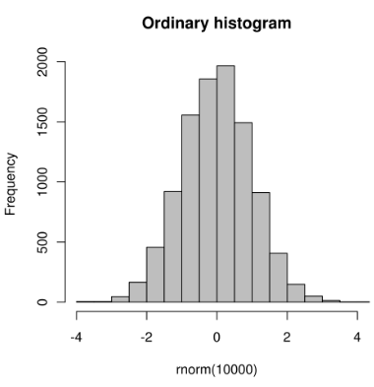
2. Meanshift method
objects whose appearance
Efficient approach to tracking
is defined by histogram
Notes:
Second, we have a meanshift method. It is an efficient approach to tracking objects whose appearance is defined by histogram. Do you know what is histogram? Histogram is a graphical representation of distribution of numerical data. See this picture. We divide the range from -4 to 4, and we represent the numerical data using sticks. We will use this histogram on the meanshift method.

Slide 17
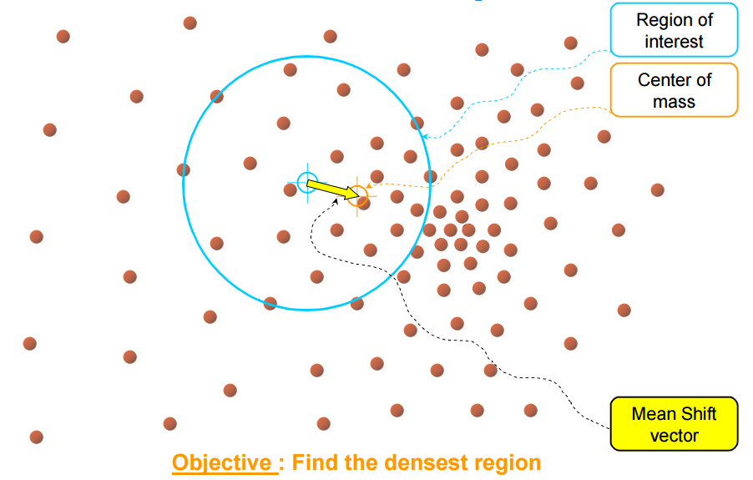
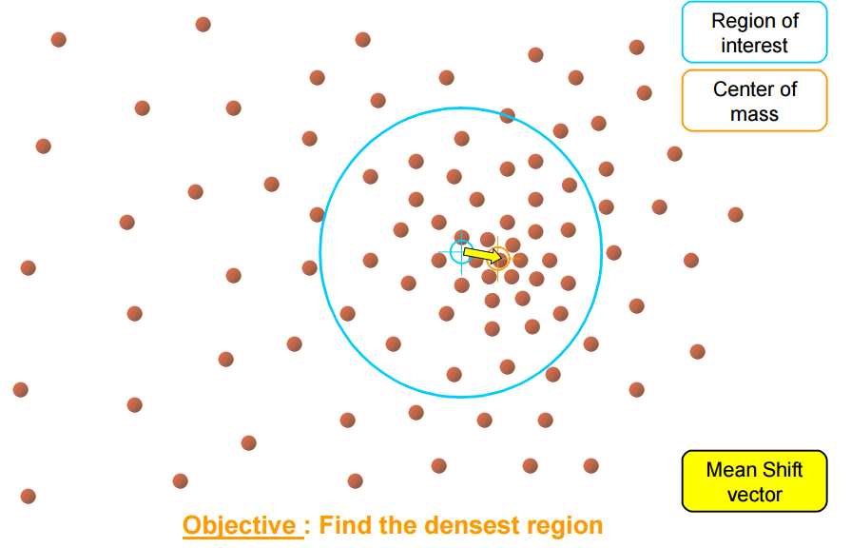
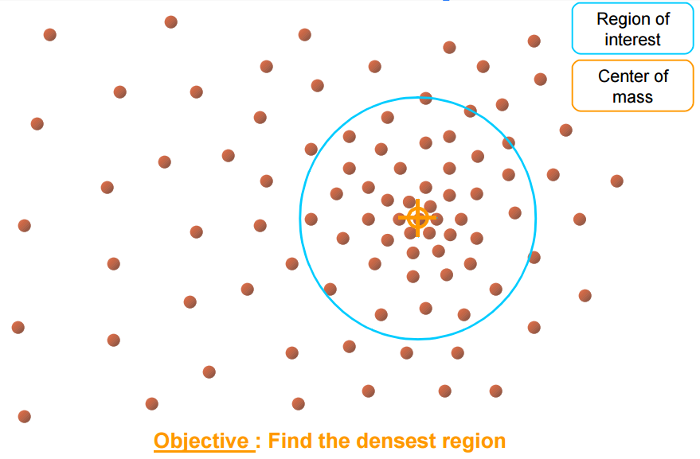
Given a small window and we have to move that window to the area of maximum pixel density.
Notes:
For example, let’s see those pictures. They have a set of points. It can be a pixel distribution. We are given a small circle and we have to move that window to the area of the maximum pixel density like this. So it tracks well even if there’s a shape deformation. However, if the color of the object is similar as surrounded objects, it is hard to track the object.
Also, both method has a problem. if the object disappear in the window for a second, we can’t tract that object anymore.

Slide 18
3. TLD
(Tracking-Learning-Detection)
Real-time algorithm for tracking of unknown objects in video streams
Notes:
So I decide to use the TLD algorithm on my project. It can solve that problem, and track better than the others. The TLD is a tracking learning detection. It is a real time algorithm for tracking of unknow objects in video streams.

Slide 19
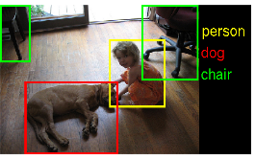
definition
Object detection :
Detect a particular object in an image
Object tracking :
To track an object(or multiple objects) over a sequence of images
Notes:
The difference between the other algorithms and TLD is the existence of an object detection. The object detection is to detect a particular object in an image, and the object tracking is to track an object over a sequence of images. The others only have the object tracking. However, TLD algorithm has both.

Slide 20
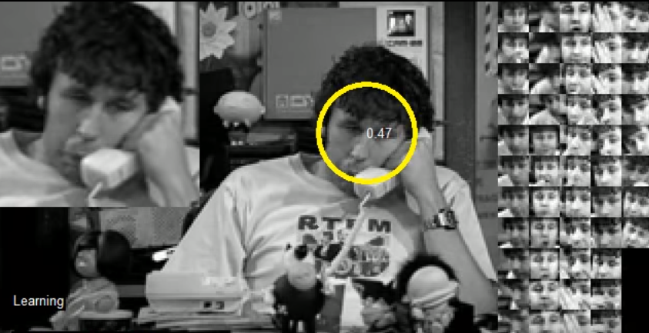
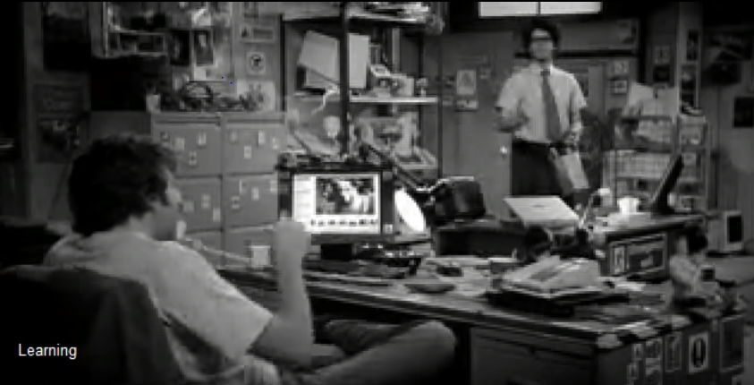
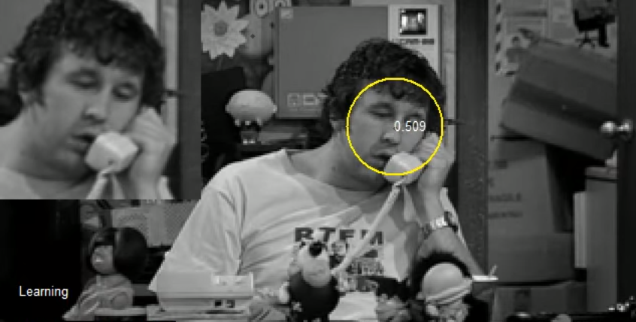
TLD simultaneously tracks the object, learns its appearance and detects it whenever appears in the video
Notes:
So, TLD algorithm simultaneously tracks the object, learns its appearance and detects it whenever appears in the video. Even if the object disappear for a second, they still have an information about the object through the object detection. So they can find the object when the object appears again.

Slide 21
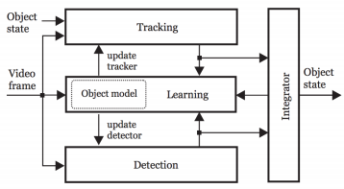
What’s the P-N tracker?
When user assigns a tracking domain, tracker and detector initialize simultaneously.
After the frames input, they find the object using both tracker and detector. If tracker succeed, makes detector more powerful.
If tracker fails, wait until detector succeed. And if it succeeds, initialize the tracker to detector’s scope and tracking again.
Notes:
In detail, they use P-N tracker. P means positive, and N means negative. When user assigns the domain that they want to track, tracker and detector initialize simultaneously. After the frames input, they find the object using both tracker and detector. If tracker succeed to find the object, the data will be updated and makes detector’s reliability more powerful. Also, if the detector find some scope, and if it isn’t correspond to the scope that the tracker found, it will be added on the negative examples. So it will also make detector’s reliability more powerful.
And if the tracker fails tracking, they wait until the detector succeeds. It the detector succeeds, they initialize the tracker to the detector’s scope, and start tracking again.

Slide 22
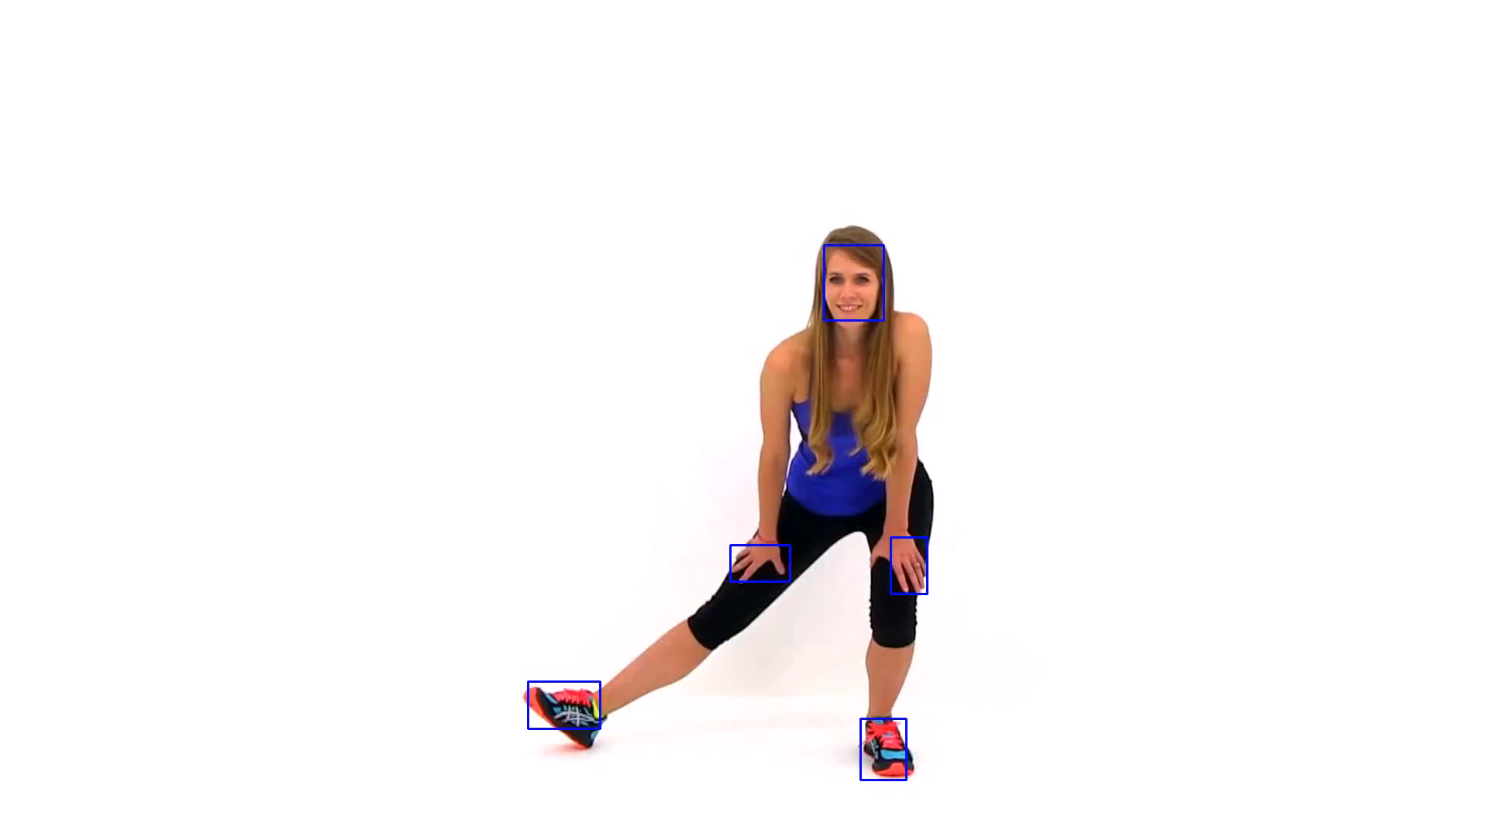
Result
Notes:
These are the pose and movement extraction result. we extract the pose and movement of a person who is exercising and tracking in real-time.

Slide 23
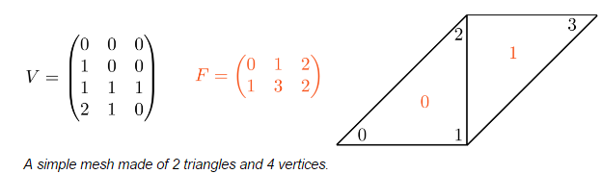
2. 3D Shape Manipulation
Store the extracted points in matrix : V - store the coordinate of the vertices.
F - store the triangle connectivity.
Notes:
Next step is 3D shape manipulation. We will use libigl library. First, we will store the extracted pose and movements in matrix. We store the coordinate of the vertices in V matrix, and store the triangle connectivity in F matrix in real time.

Slide 24
As Rigid As Possible
Use Non-linear deformation techniques
The shape is represented by a triangle mash.
Computes the positions by minimizing the distortion of each triangle.
Minimize the error of changing the complicated shapes such as non-trivial bending and twisting.
Notes:
And we will use the “As-rigid-As-possible in the libigl which has the Non-linear deformation techniques. A shape is represented by a triangle mash, and it is deformed by a set of control points we extract. These will extends 2D to 3D on moving. The system will computes the positions by minimizing the distortion of each triangle. The key idea is to use non-linear deformation techniques so that they can minimize the error of changing the complicated shapes such as non-tirival bending and twisting.

Slide 25
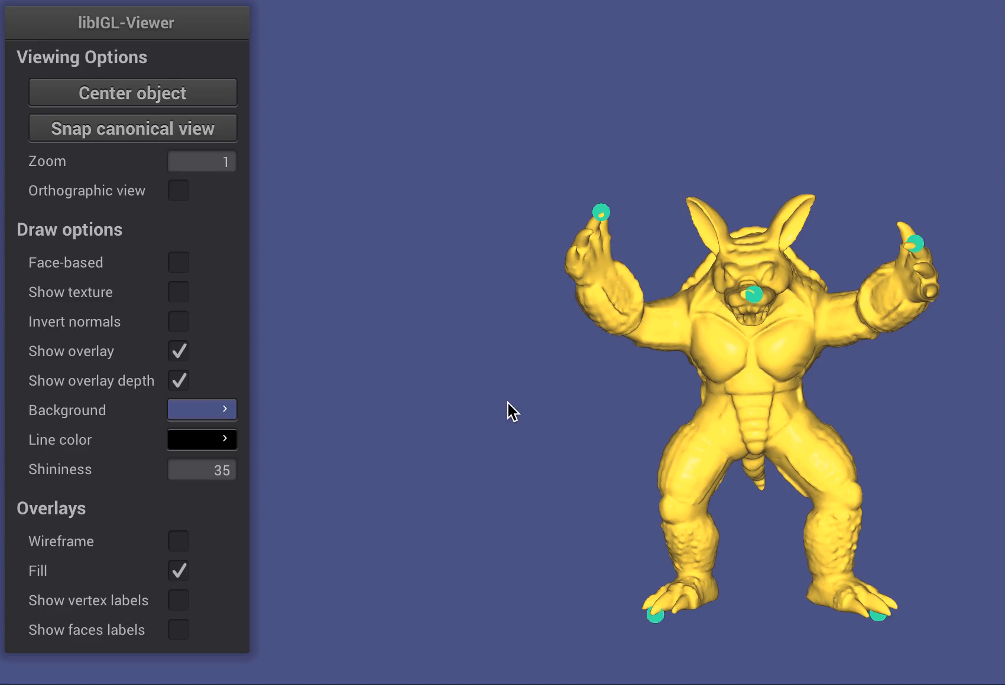
Result
Notes:
This is the result of 3D shape manipulation. It can move smoothly. We just put the video and make a pose and movement easily through this program, even non professional can use this program easily.

Slide 26
Thank you!
Notes:
Thank you for listening. Any questions?

